Slide 1
PLUGIN 1 (ImageJ) Registration of the entire image then Crop then Save the registered image sequence
Input folder: folder containing the folders exported from the microscope that should be named measurement1, …
Output folder: creates folders called Measurement1, … in desired destination
PLUGIN 2 (ImageJ) Extract (copy) one file (we choose #5 of the donor pre-bleaching) from each FOV measurement. Save each of them in the same folder. Input: output of Plugin 1
Output: single images in separate folder

Slide 2
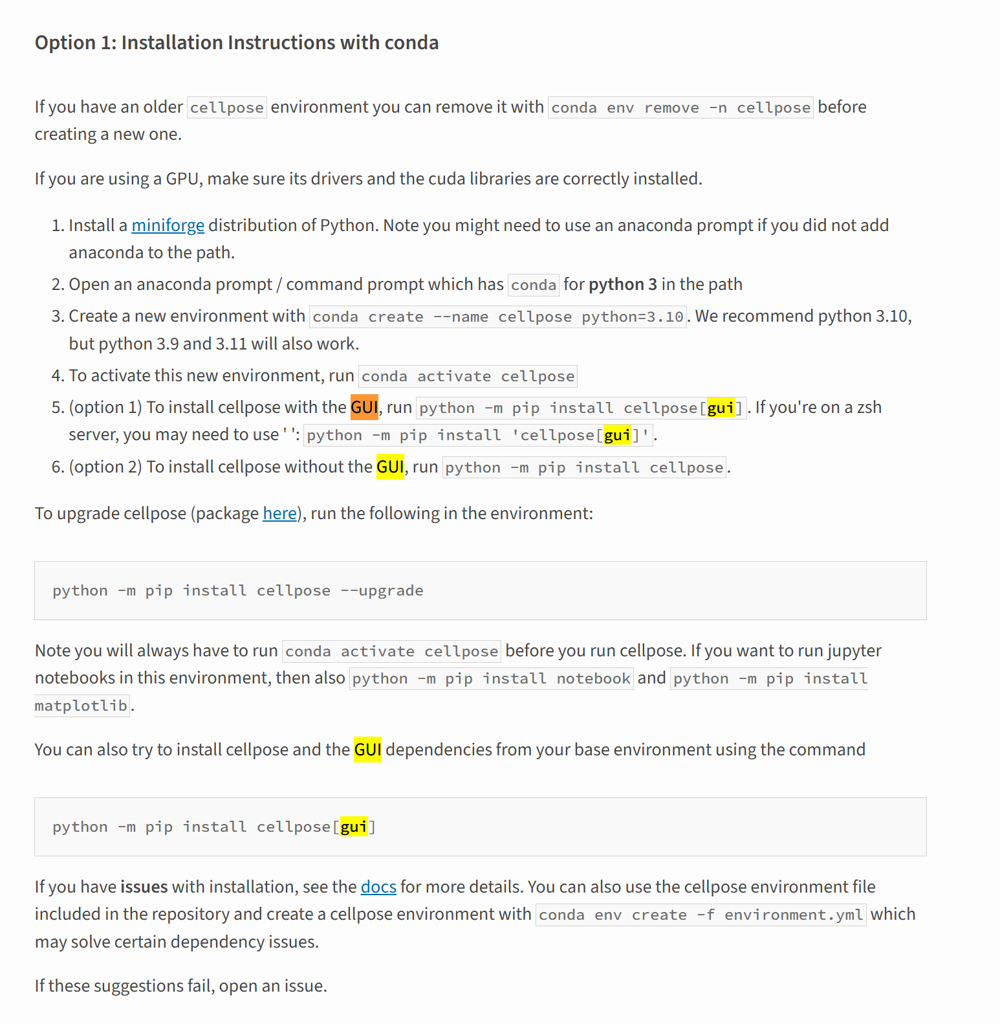
Cellpose
https://pypi.org/project/cellpose/#:~:text=(option%201)%20To%20install%20cellpose,python%20%2Dm%20pip%20install%20cellpose%20.

Slide 3
Cellpose
YOU JUST NEED TO BE IN C:\Users\malengoG> (with your own name of course)
AND THERE YOU NEED TO WRITE: conda activate cellpose which brings you to: (cellpose) C:\Users\malengoG>
Visualize the GUI interface which is a good idea to check how things work you need to write: python -m cellpose However the GUI only allows to run the segmentation of one image at a time so it´s not very practical. Therefore run the following, note that it doesn´t seem to work unless you write it in one line (just copy in word and use very small font) (input: output of Plugin 2; output will be saved in the same folder as input):
cellpose --dir "Q:\Members\Lisa Werland\Results\2 Dynamics of regulation of PhoQ by SafA and MgrB\1 Bleach FRET\4 Binding affinity\20250327\input images for cellpose" --pretrained_model bact_fluor_cp3 --diameter 25 --save_tif --save_png --save_outlines --save_rois --save_txt --verbose
The value of 25 for the diameter is the result of the optimization ran on the calibration

Slide 4
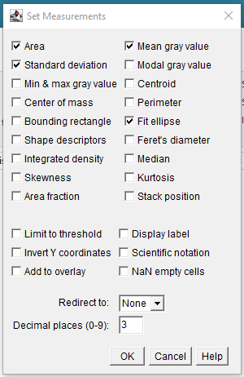
PLUGIN 3 (ImageJ)
Make new folder „Analysis Bleaching“ by hand
Measuring the ROIs discriminating the bleached and unbleached ones.
Input folder images: output folder of Plugin 1
Input folder ROI zip foles: output folder of Plugin 2
Bleached/Unbleached ROI: draw by hand based on a few image sequences
Output: new folder with .csv files
Make sure „Set Measurements“ looks like this:

Slide 5
PLUGIN 4 (Python) to run in Anaconda, handling the results from bleach fret and creating a new file.
Copy output of Plugin 3 to C:\Users\WerlandL\FRET (input for Plugin4.py)
In Anaconda go inside C:\Users\WerlandL
Run Plugin4.py
Saves output in C:\Users\WerlandL\FRET2
PLUGIN 5 (Python) to run in Anaconda, handling the results from bleach fret and creating a new file.
Change BG lines 34 & 83
In Anaconda go inside C:\Users\WerlandL
Run Plugin5.py (uses C:\Users\WerlandL\FRET2 as input and saves output in C:\Users\WerlandL\FRET3)
PLUGIN 7 (Excel) we need to use an excel macro to convert csv in xlsx as when we do it with python it does it but the next step constantly fails
Open new Excel sheet
Developer → Macros → paste text of Plugin7.txt
Select all → Run (uses C:\Users\WerlandL\FRET3 as input and creates subfolder „XLSX“)
PLUGIN 8 (Python) this gives us transposed readable files
In Anaconda go inside C:\Users\WerlandL
Run Plugin8.py (uses C:\Users\WerlandL\FRET3\XLSX as input and overwrites the original files as output)
PLUGIN 9 (Python) this gives us transposed readable files and cut bleached <70%
In Anaconda go inside C:\Users\WerlandL
Run Plugin9.py (uses C:\Users\WerlandL\FRET3\XLSX as input and creates files DaySummaryIN and DaySummaryOUT as output)

Slide 6
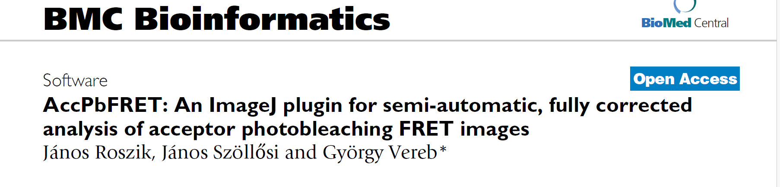
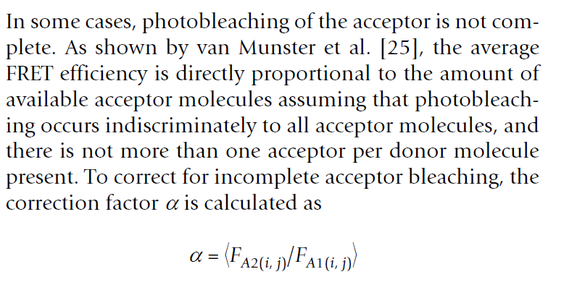
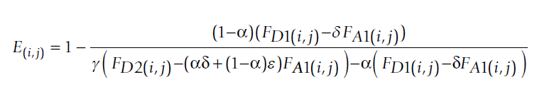
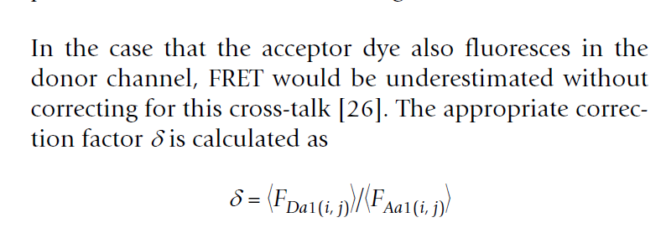
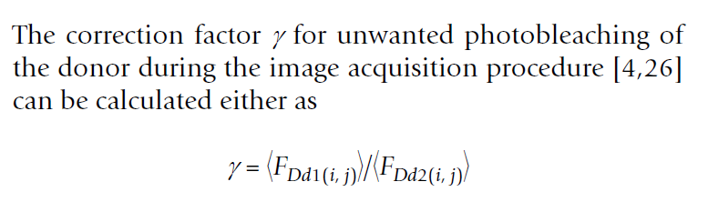
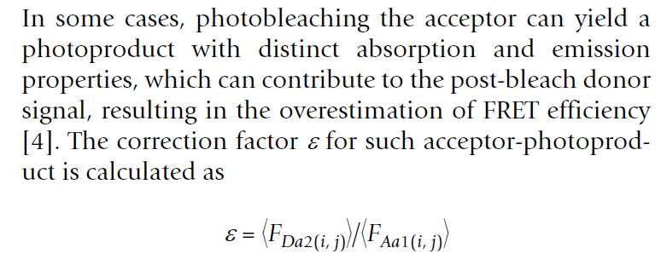

Slide 7
